Slide 1
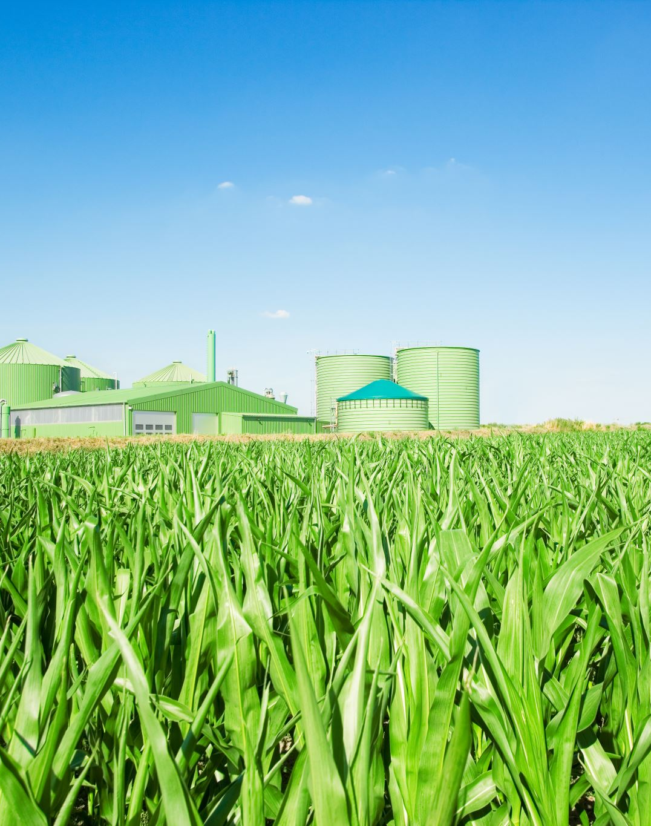
Project 1- Crop Production Analysis
Created by- Abhishek Bhola

Slide 2
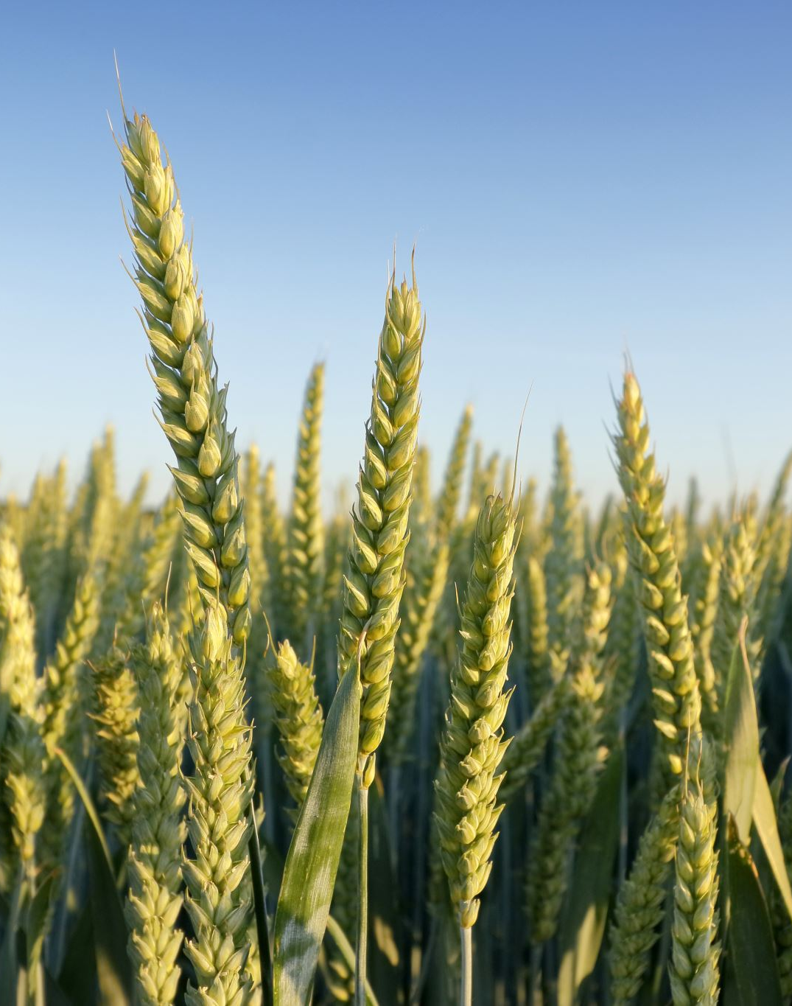
INTRODUCTION
This dataset provides a huge amount of information on crop production in India ranging from several years. Based on the Information the goal would be to predict crop production and find important insights highlighting key indicators and metrics that influence crop production.

Slide 3
My Project Details
Tools- Tableau Public
Technologies- Data Science
Domain- Agriculture
Project Difficulty Level- Advance

Slide 4
Main KPIs
Area : Over the Years and its distribution by ‘Season’
Production: Over the Years and its distribution by ‘Crops’
Region: State and District wise Production
Relationship b/w Area and Production
Different types of Crops by ‘Area’ and ‘Production’ both

Slide 5

Key Analysis Questions

Slide 6
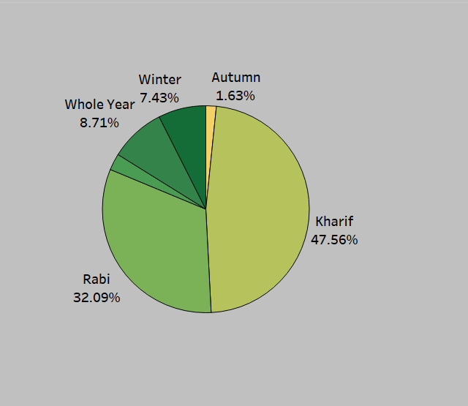
1. Which Season having the major Area?
KHARIF Season

Slide 7
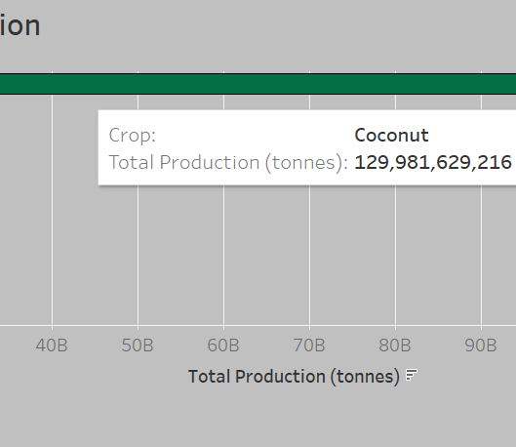
Top 5 Crops by Total Production
Coconut
Sugarcane
Rice
Wheat
Potato

Slide 8
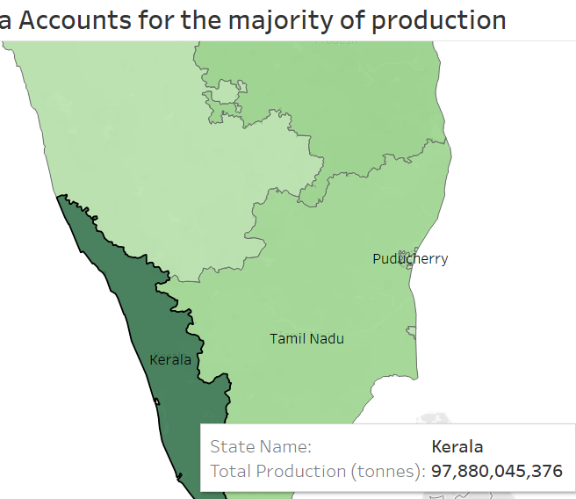
3. Which State having the Majority of Production ?
KERALA STATE

Slide 9
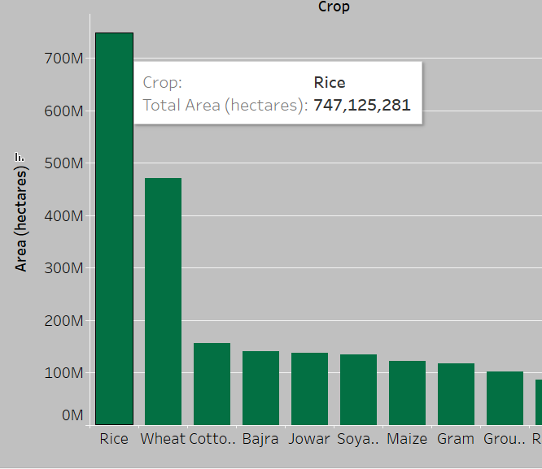
4. Which Crop noticeably higher Area ?
RICE Crop

Slide 10
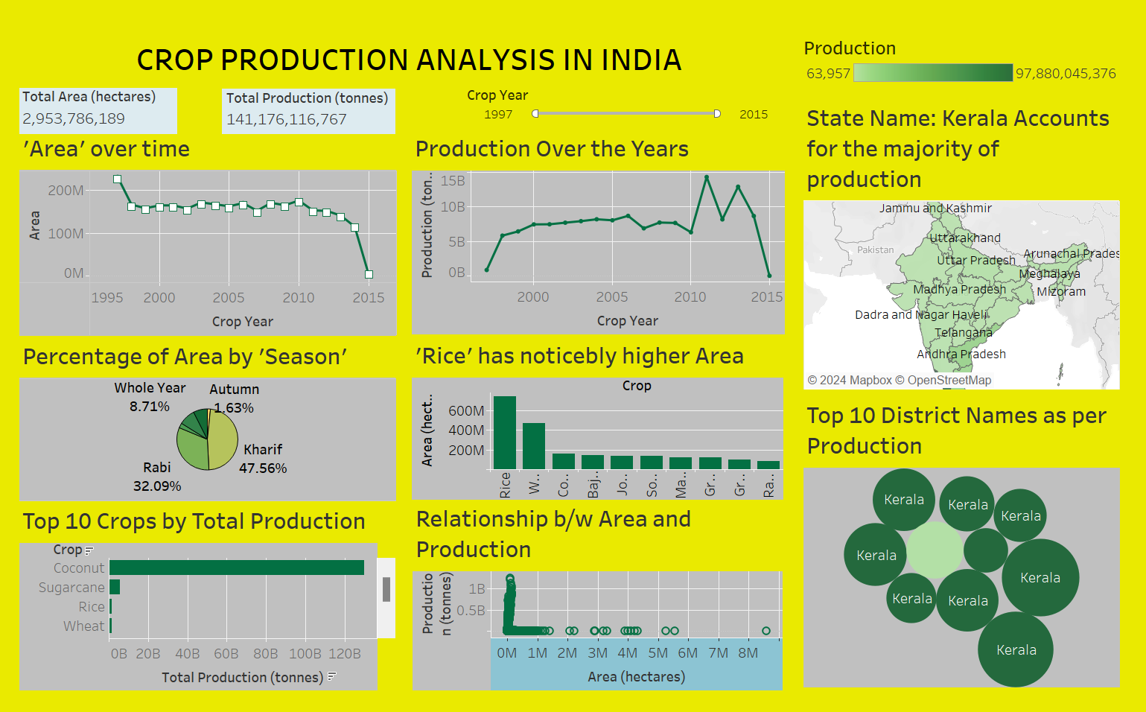
MY DASHBOARD DESIGN

Slide 11
Links
My Github- https://github.com/Bhola90/Data-Science-Projects
My linkedin- www.linkedin.com/in/abhishek-bhola-25891865

Slide 12

Thank You

